Slide 1

Real-time Software Engineering
(RTSE)
Week 3- Requirement Analysis and Design
Department of software engineering
Faculty of Computing
UTM

Slide 2
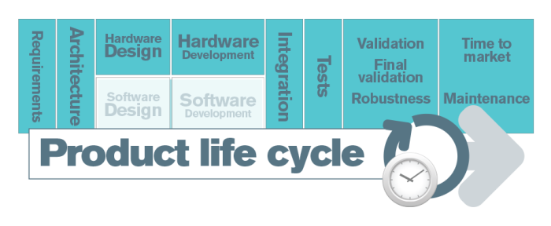
Introduction
What is requirements analysis and design
Why this process is very important
What is the challenge
Practical approaches
What is a suitable Software process model for ERT system
Summary
Problem Solving
SCSJ 4423 – Real-time Software Engineering

Slide 3
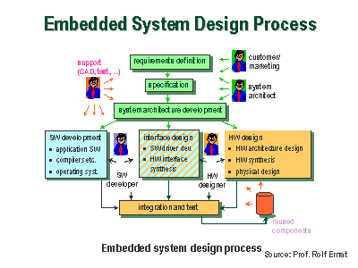
Requirement analysis and design for ERT system
SCSJ 4423 – Real-time Software Engineering

Slide 4
Why this process is important
Cost of rectifying software errors
Distribution of software errors
Code
Other
Design
1%
4%
Code
Other
13%
7%
10%
Design
Requirements
27%
56%
Requirements
82%
Incomplete software requirements
Increase a software error
High software error lead to high cost for rework
Wrong software expectation
Complete system with faults.
SCSJ 4423 – Real-time Software Engineering

Slide 5
Challenges
Customer
Supplier
Information
Problem requirements formulation
Problem evaluation
Communication
Knowledge
Design solution
Challenges
Formulating specification
Communicating requirements
Understanding requirements
SCSJ 4423 – Real-time Software Engineering

Slide 6
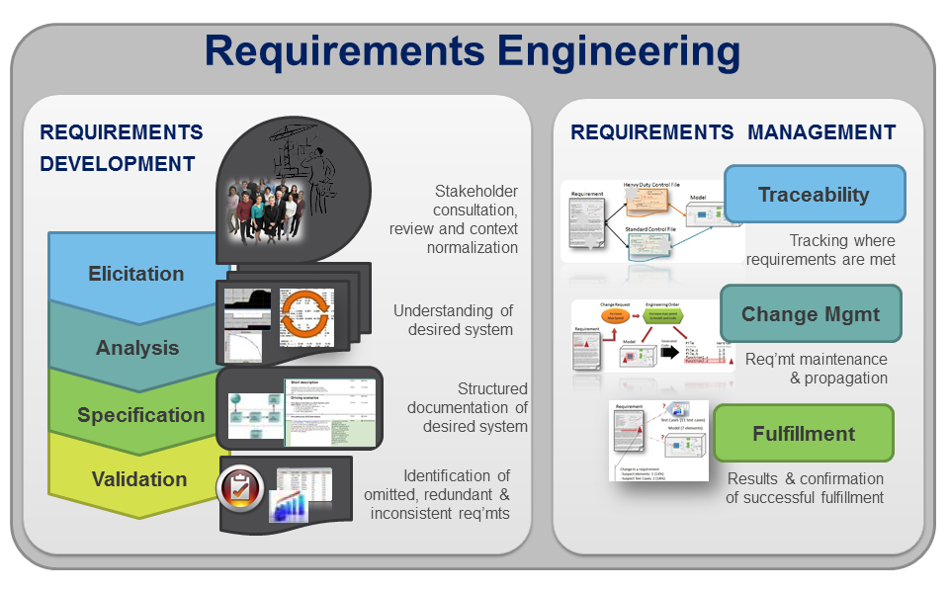
Practical approaches for requirements analysis
SCSJ 4423 – Real-time Software Engineering

Slide 7
Practical approaches for requirements analysis
System requirements
Functionality
Non-
functionality
Interfaces
Constraints
What the system suppose to do
How the system cope with the software quality, performance, reliability, etc
Real world and software world
Do’s and don’t’s
Tool supports
Difficult to find a standard tool for analysis and design
Formal method is the best but difficult to be applied
SCSJ 4423 – Real-time Software Engineering

Slide 8
Practical approaches for requirements analysis
FUNCTIONAL REQUIREMENT SPECIFICATION FOR MRCA AVIONICS:
SYSTEM: Flight Control.
SUBSYSTEM: Autopilot.
Functionality
The autopilot, when in hard mode, is required to control altitude to 150 metres, plus or minus 3 metres. at airspeeds up to 500 knots. | 1. Process:
Altitude, airspeed and groundspeed. Terrain-following radar. Angle of attack. Roll, pitch and yaw gyros. Stick demand. | 2. Inputs:
Aileron, rudder and elevator servo commands. | 3. Outputs:
Loss of altitude or radar signals. | 4. Major error:
Disengage autopilot normal mode, engage emergency mode. | 5. Exception response:
SCSJ 4423 – Real-time Software Engineering

Slide 9
Practical approaches for requirements analysis
NON-FUNCTIONAL REQUIREMENT SPECIFICATION FOR MRCA AVIONICS:
SYSTEM: flight Control. SUBSYSTEM: Autopilot.
Non-
functionality
1. PERFORMANCE:
Computation: The control algorithm is of the form
Ka[(1 +ST,)( 1 +ST 2)]/[( 1 +ST 3)(1 +ST.)]
Computation time: This must be achieved in 5 milliseconds.
Computation accuracy: Calculations must be accurate to within 0.01%. Control loop update rates: 100 per second.
Variation on loop sampling time: 1 millisecond from sample to sample. Response to loss of altitude signal: 100 microseconds maximum. Redundancy: Quad redundant processor system.
System fault handling: Majority voting on processor outputs.
Mean Time Between Failures (MTBF) per control channel: 5000 hours. Reliability per control channel: 99.98%.
Mean Time To Repair (MTIR) per control channel: 1 hour.
Storage capacity: 1 MByte.
SCSJ 4423 – Real-time Software Engineering

Slide 10
Practical approaches for requirements analysis
Interfaces
2. INTERFACES.
2.1 Interfaces - MMI.
The pilots will be able to select hard, medium or soft rides via a touch screen facility on the head down display.
2.2 Interfaces - Aircraft.
(a) Analogue input signals: These are derived from the following sources:
Altitude, airspeed and groundspeed. Terrain-following radar.
Angle of attack.
Roll. pitch and yaw gyros. Stick demand.
All are digitized using a 12 bit analogue-to-digital converter having a conversion time of 10 microseconds.
(b) Analogue output signals: These are fed to the following items:
Aileron, rudder and elevator servo controllers.
A 12 bit digital-to-analogue converter is used on the output of the controller.
(c) Avionics data bus: All state information is to be fed out onto the aircraft Mil-Std 1553 data bus.
2.3 Interfaces - Software.
The application software will be designed to interlace to the VRTX32 real-time executive.
SCSJ 4423 – Real-time Software Engineering

Slide 11
Practical approaches for requirements analysis
Constraints
3. DESIGN CONSTRAINTS.
Programming language: Ada95.
Operating system: VRTX32.
Avionic's data bus communication protocols: Mil-Std 1553b.
Processor type: Motorola PC604.
Maximum memory capacity (including expansion capability): 500 Kbytes. Spare processor performance capacity on delivery: 50% min.
Documentation: JSP188.
4. OTHER CONSTRAINTS.
Maximum size: Half ATR case size.
Maximum weight: 10 lb.
Temperature range: -55 to + 125 degrees centigrade.
Servicing policy: Line replaceable unit.
Test: Built-in test to identify faults to unit level.
SCSJ 4423 – Real-time Software Engineering

Slide 12
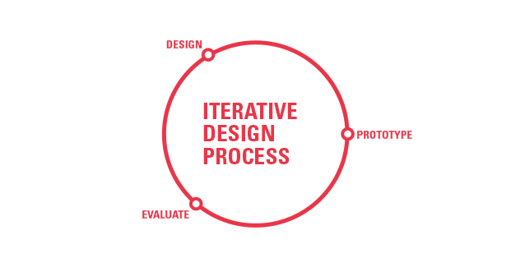
How to communicate with stakeholders- using prototype
Useful at,
Benefits
  The requirements engineering process to help with requirements elicitation and validation;
  In design processes to explore options and develop a UI design;
  In the testing process to run back-to-back tests.
Improved system usability.
A closer match to users’ real needs.
Improved design quality.
Improved maintainability.
Reduced development effort.
SCSJ 4423 – Real-time Software Engineering

Slide 13
Types of Prototype
Solution
Exploratory
Investigative
Animation
Evolutionary
Rapid
Requirements
SCSJ 4423 – Real-time Software Engineering

Slide 14
Design
A process to convert a system specifiction into a executable system
Expend descriptive model into something specific by tackling the following factors:
Identify subsystems
Identify interface between subsystems
Evaluate subsystem interaction
Identify work-loading and allocation
Assess man-power req.
SCSJ 4423 – Real-time Software Engineering

Slide 15
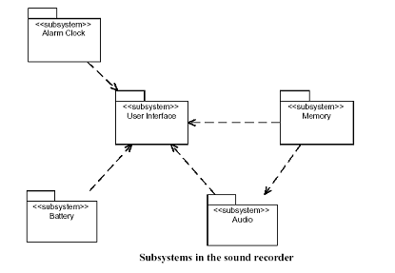
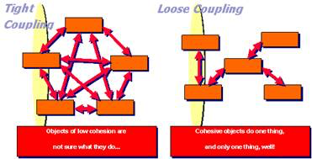
Design – Important elements
Modules/Packages
Size and complexity
SCSJ 4423 – Real-time Software Engineering

Slide 16
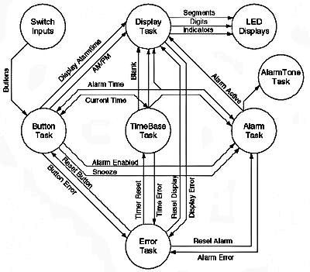
Design methodologies- Data flow design
SCSJ 4423 – Real-time Software Engineering

Slide 17
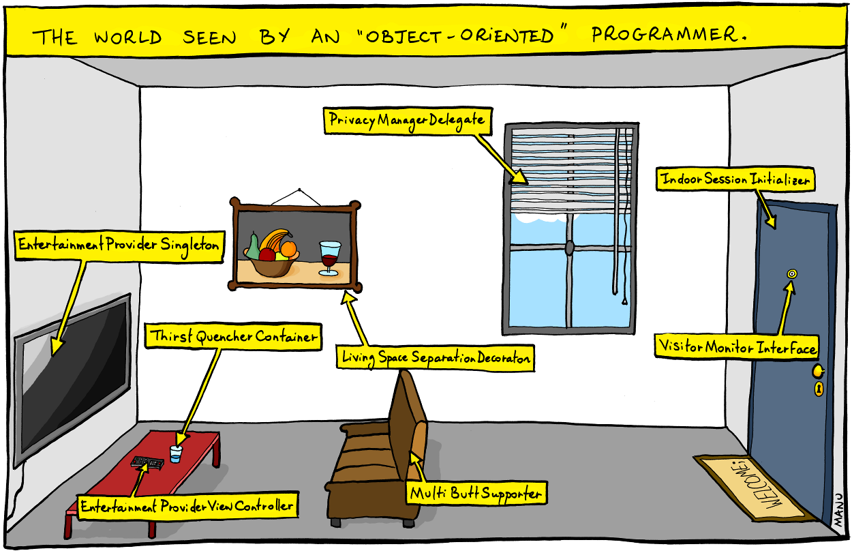



Design methodologies - OO
Profiles
SCSJ 4423 – Real-time Software Engineering

Slide 18
UML-MARTE Profile
UML Profile
Class Diagram
Sequence Diagram
Cross reference with UML MARTE Profile
SCSJ 4423 – Real-time Software Engineering

Slide 19
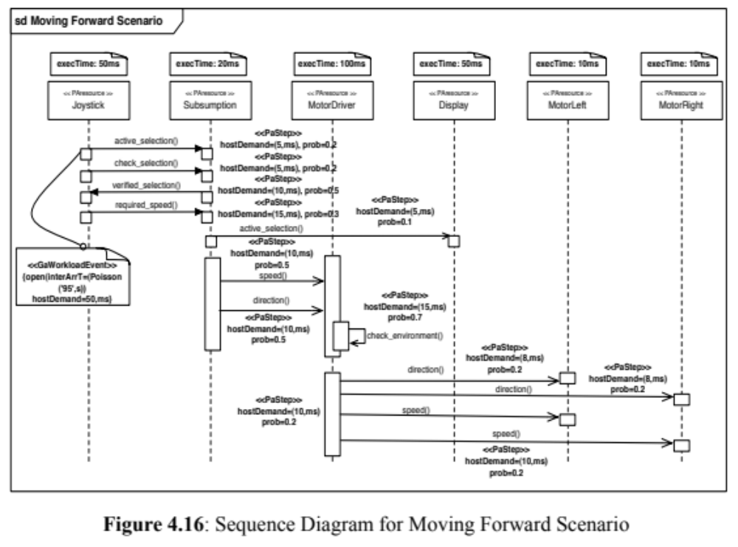
Example of SD using UML-MARTE
UML Profile - SD
SCSJ 4423 – Real-time Software Engineering

Slide 20

Thank You
SCSJ 4423 – Real-time Software Engineering

Slide 21

Problem solving 2
Start with your group
  Based on the case study in PS1, identify and explain in detail (THREE): Functionality, Non-functionality (Security), Interfaces and Constraint.
  Draw a package diagram with a tag value for <<subsystem>> for your case study.
  Submit during a class
SCSJ 4423 – Real-time Software Engineering

